Slide 1
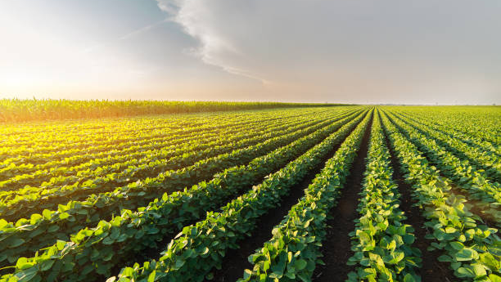
The Future Price
of Soybeans
Commonwealth: Zhengfang Bao, Zhaoying Chen, Siyu Liu, Fernanda Lin

Slide 2

Conclusion:
The Soybean’s Price will Increase
In the following 60 days:
Mar 20 will hit 990
May 20 will hit 1000
Jul 20 wil hit 980

Slide 3
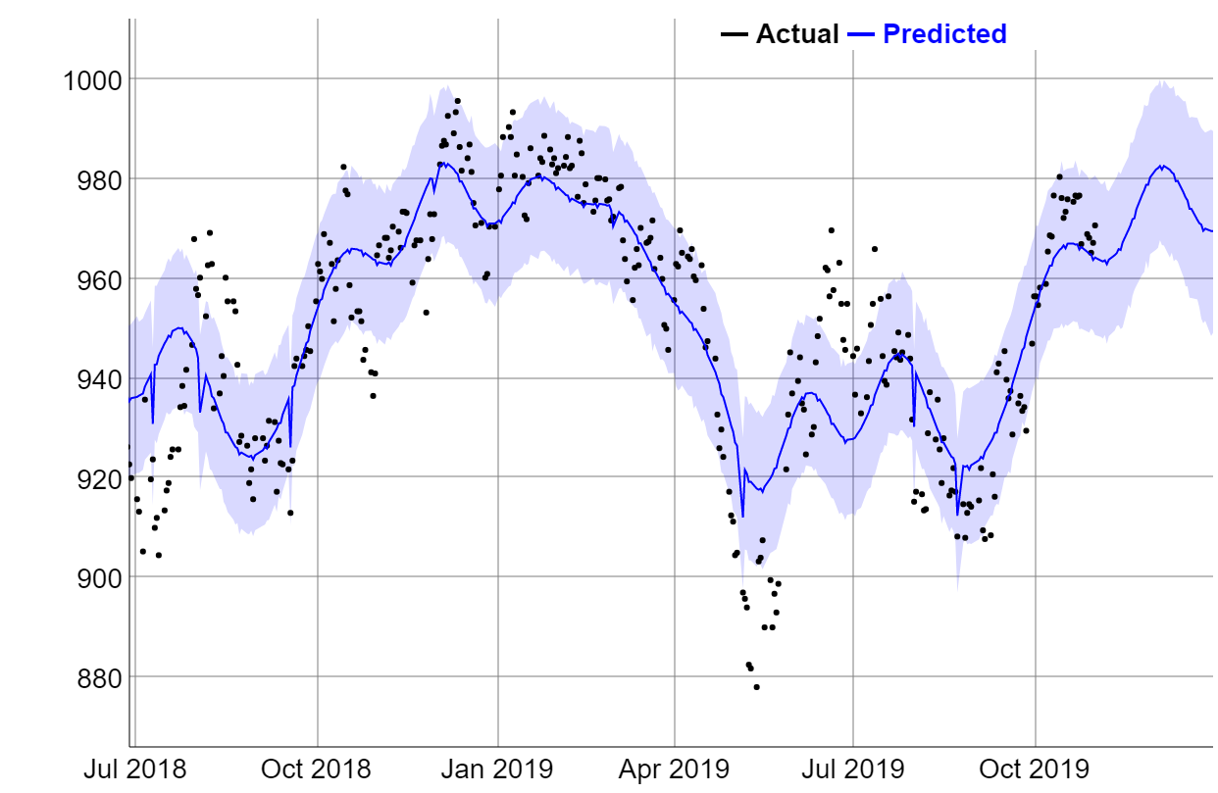
Per Model Prices Are Increasing
July 20 Contract Prediction
Notes:
Per model prices are going up
Start from jul

Slide 4
Supply and Demand Drive Soybean Prices UP
Increase in demand
Better living standards for people in China -Increase in GDP per Capita
Decrease in Supply
Drought (Brazil)
Tariffs (US- China trade war)
Other factors might consider:
Twitter
African Swine Flu(China)
Notes:
Quantitative and qualitative approach
Nebraska : thechnology/ equipment strong in the us

Slide 5
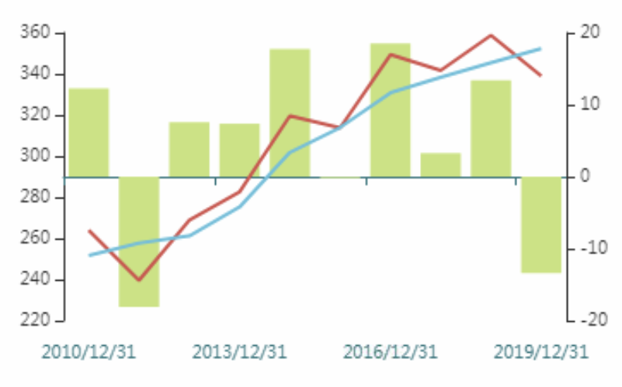
Supply and Demand Contribute to Price Increase
MTon
MTon
Worldwide soybean production
Total consumption by China
Surplus/Deficit
Source: Wind
Notes:
Wind

Slide 6
Appendix
Detailed information of prophet
Prophet Package Yields the Lowest Error
Factors Affecting Soybean Prices are Correlated to Each Other
March 2020 Contract Suggests Increase in Prices in the next 60 days
May 2020 Contract Suggests Increase in Prices in the next 60 days
Soybeans Supply and Demand
China Accounts for 88% of the Soybean Market Growth
China Imports from the US Decrease by 21,704 mmt
China Increases Exports from Brazil
China’s Consumption of Soybean products Expected to increase
Tariff Impact
US Export Decrease Due to Tariffs Imposed by China
China’s Soybean Import Growth Slows down as Tariff is Implemented
Trump Tweets
Trump’s Tweets do not Affect our Prediction
Sensitive analysis on Trump’ tweet
Tariff Tweets have Minimal Effect on Market Price
References
Bibliography
Articles
Executives and Experts
Notes:
Chinese imports exports consumptions bibliography etc

Slide 7
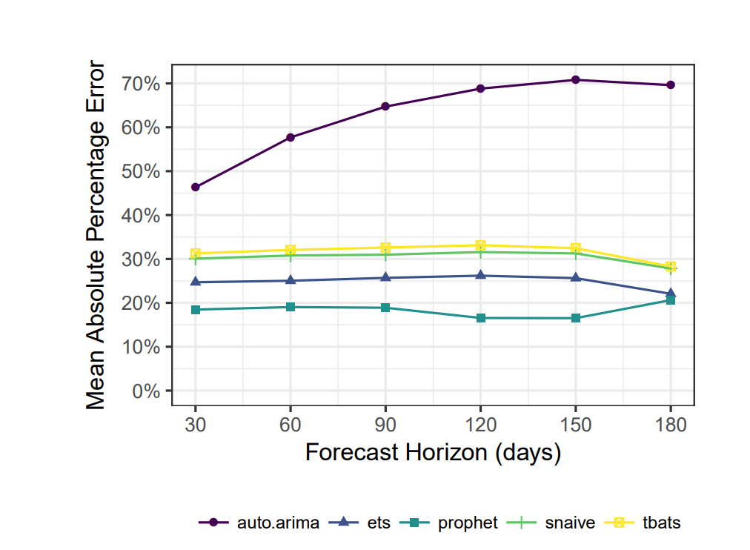
Prophet Package Yields the Lowest Error
Source: Prophet

Slide 8
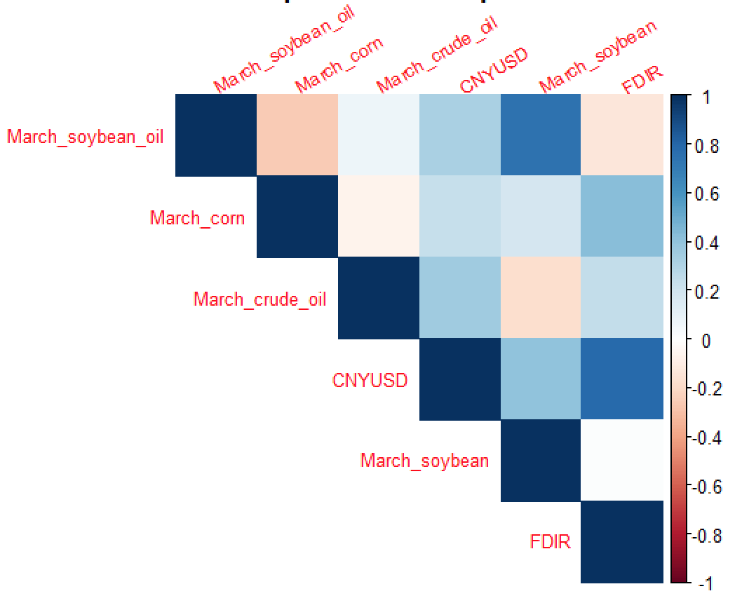
Factors Affecting Soybean Prices are
Correlated to Each Other

Slide 9
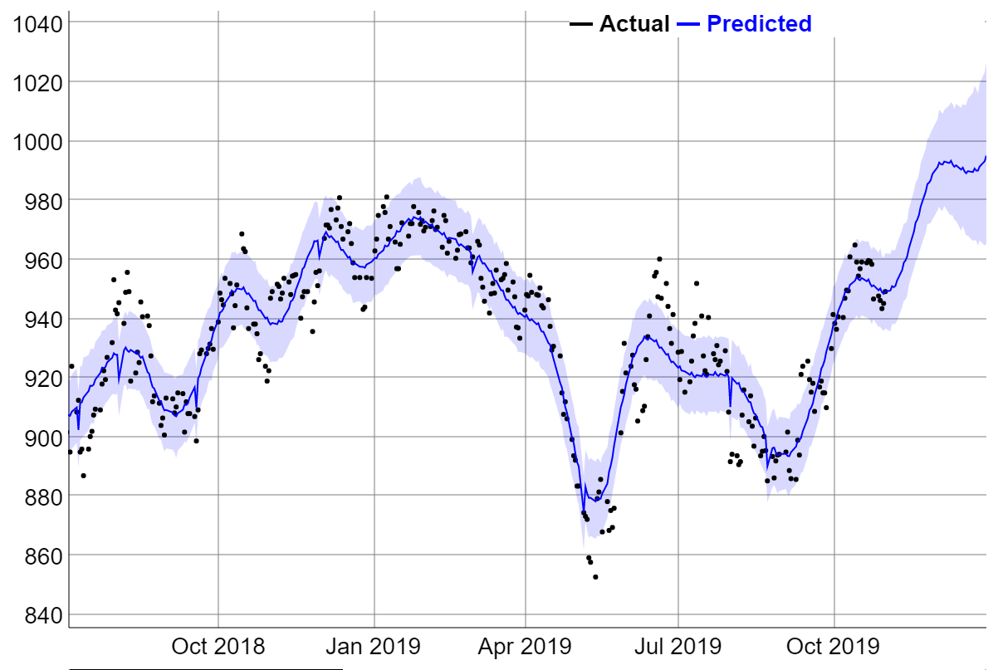
March 2020 Contract Suggests Increase in
Prices in the next 60 days

Slide 10
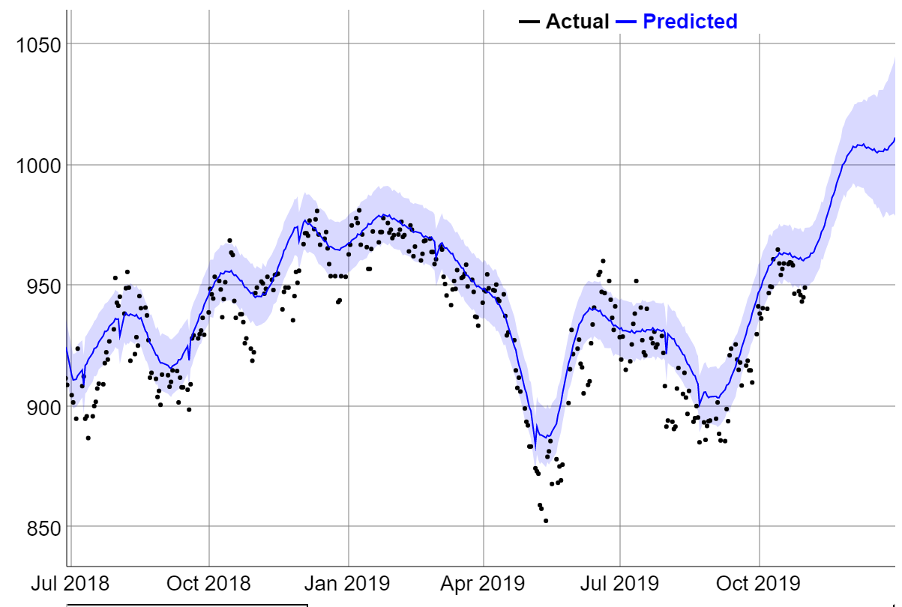
May 2020 Contract Suggests Increase in
Prices in the next 60 days

Slide 11
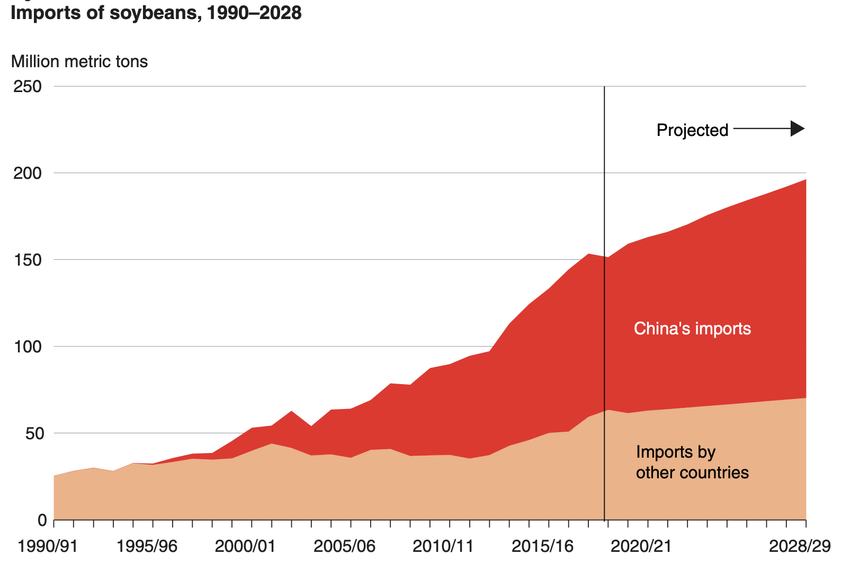
China Accounts for 88% of the Soybean Market Growth
Souce: USDA.
Notes:
After rising nearly 65 mmt from 2006 to 2016, China’s soybean imports declined during 2018 for the first time in 15 years. Signs of slower import growth were already evident before trade tensions arose, and USDA’s 2018 baseline projected a 46-mmt increase in China’s soybean imports for 2017–27. USDA (2019) projections for 2018–28 were made after China assessed a retaliatory tariff on U.S. soybeans, and the projections assume the tariff will remain in effect indefinitely. The latest projections show a slower 38-mmt increase in China’s soybean imports during 2018–28 (see box, “USDA Agricultural Projections to 2028”). Despite the slower pace of growth, China’s rising imports would still account for 85 percent of the growth in global soybean trade during 2018–28.

Slide 12
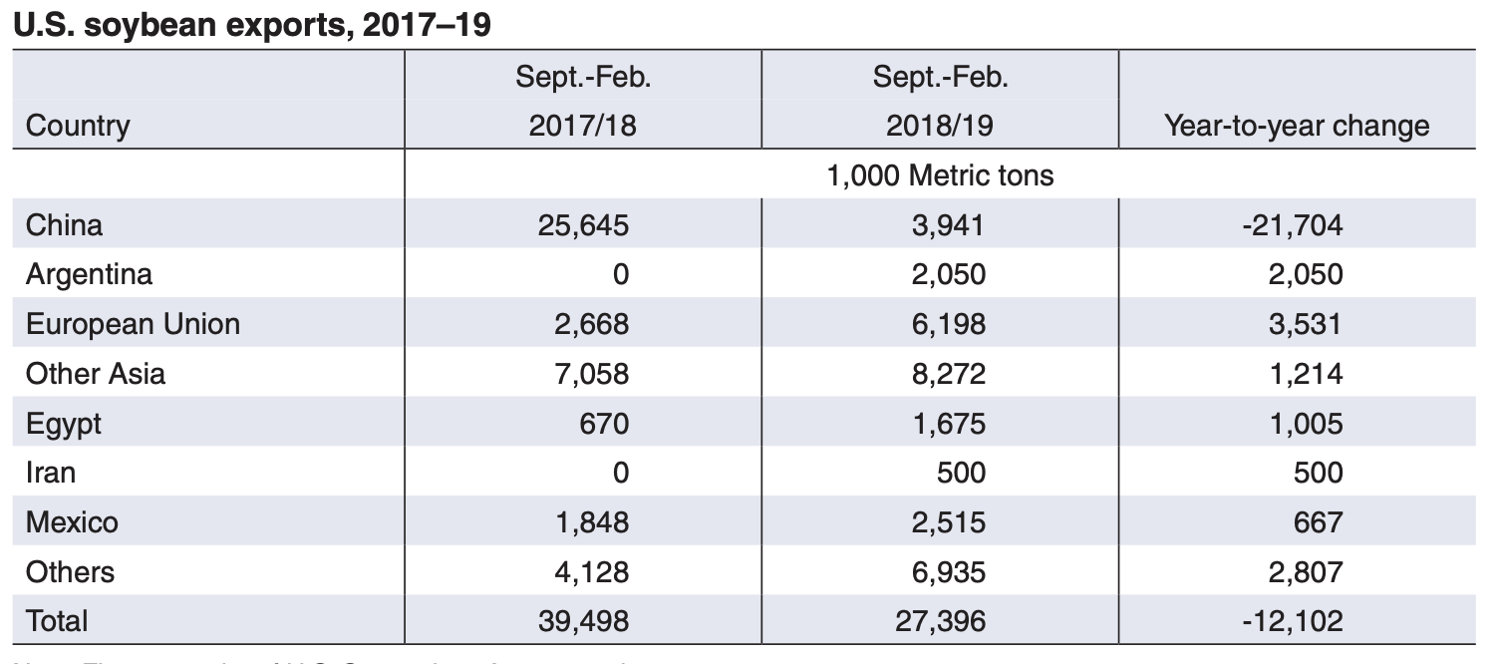
China Imports from the US Decrease by 21,704 (thousand metric tons)
Source: USDA

Slide 13
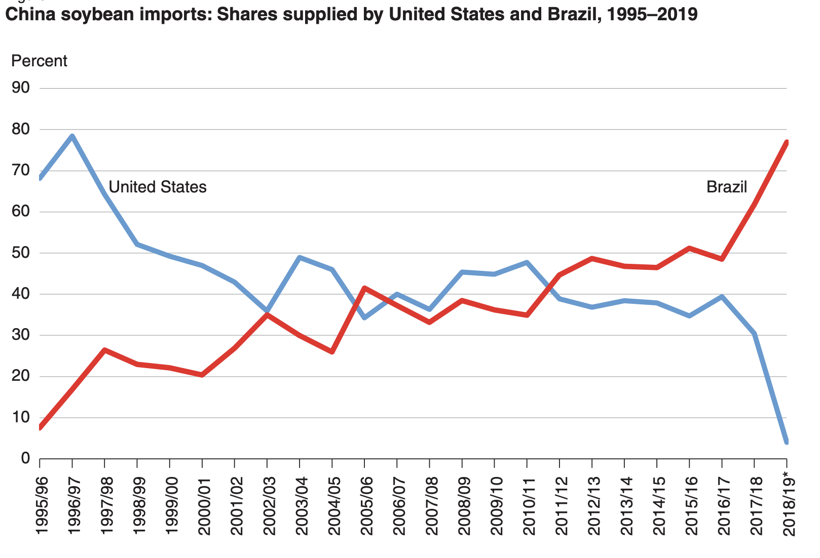
China Increases Exports from Brazil
Source: USDA
Notes:
China’s imports from the United States and Brazil have distinct seasonal patterns corresponding to different harvest times in the northern and southern hemispheres. Chinese customs statistics show that arrivals of U.S. soybeans in China typically peak during November to March each year, while arrivals of Brazilian soybeans peak during May to September (fig. 12). Conversely, minimal amounts of Brazilian soybeans arrive during December to February, and few U.S. soybeans arrive during June to August. During 2018, China’s imports of Brazilian soybeans continued at high volumes through August to December when China normally begins importing from the United States.

Slide 14
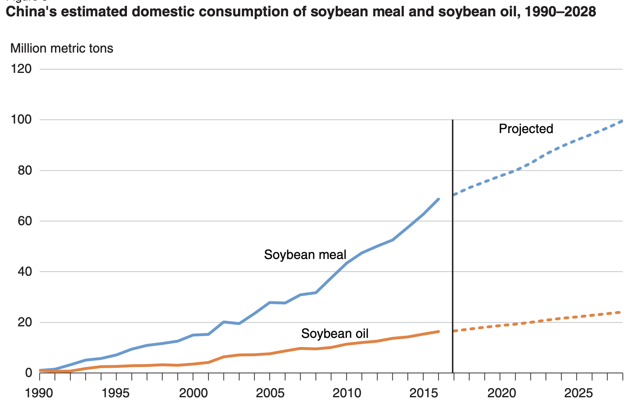
China’s Consumption of Soybean Products Expected to Increase
Source: USDA

Slide 15
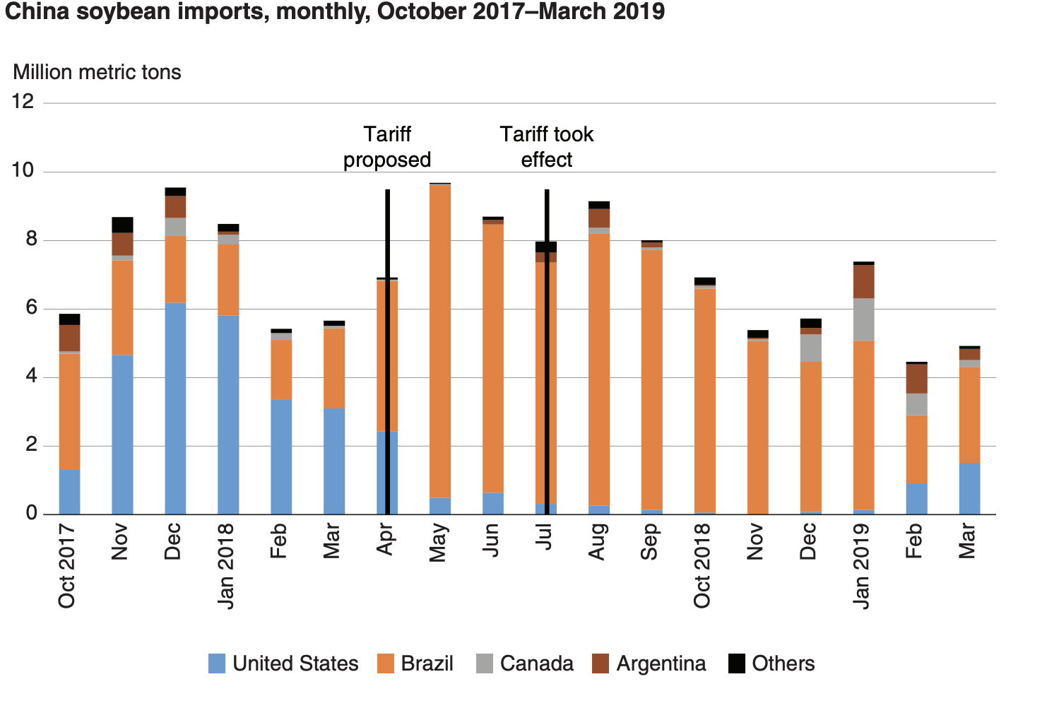
US Export Decrease Due to Tariffs Imposed by China
Source: USDA
Notes:
US Export due to tariff

Slide 16
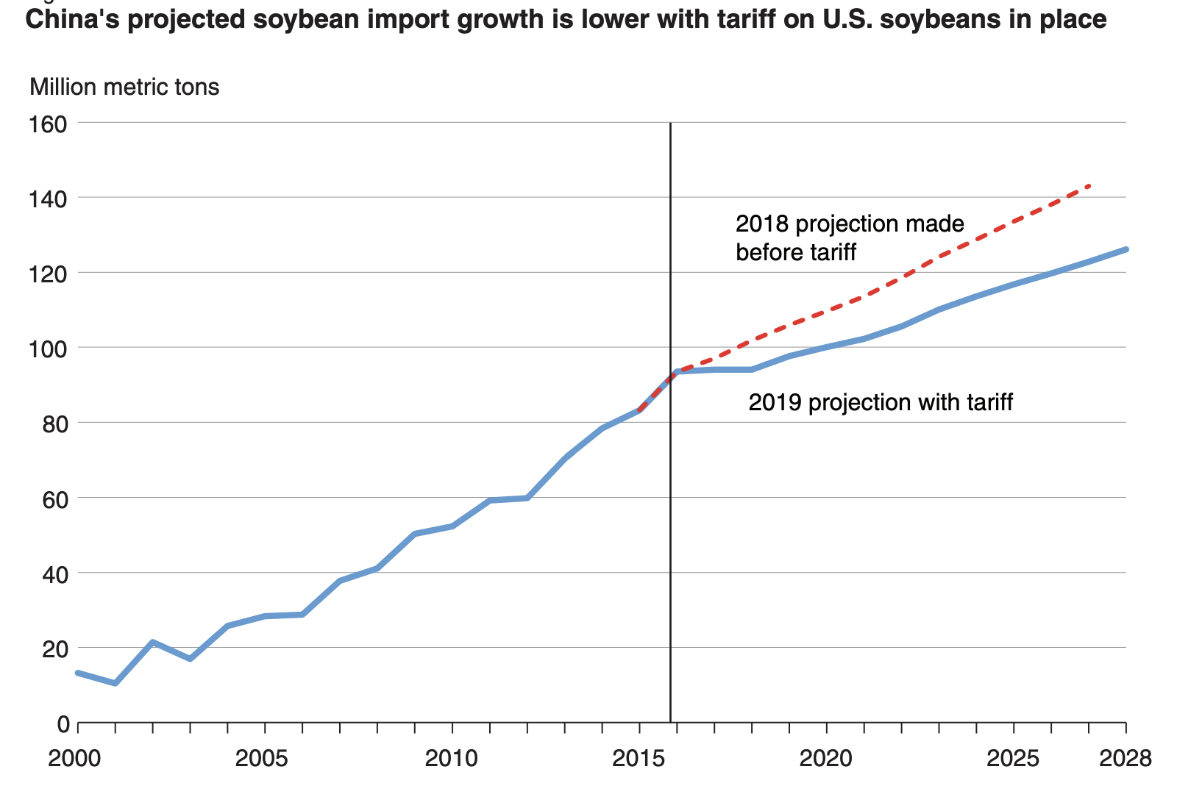
China’s Soybean Import Growth Slows down as Tariff is Implemented
Source: USDA

Slide 17
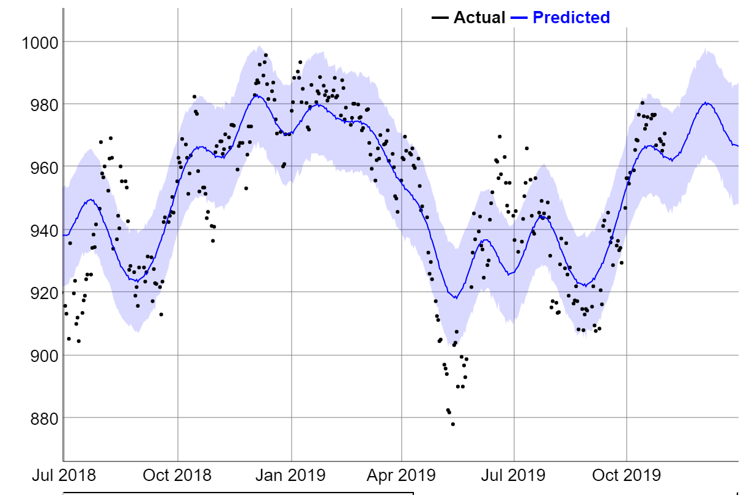
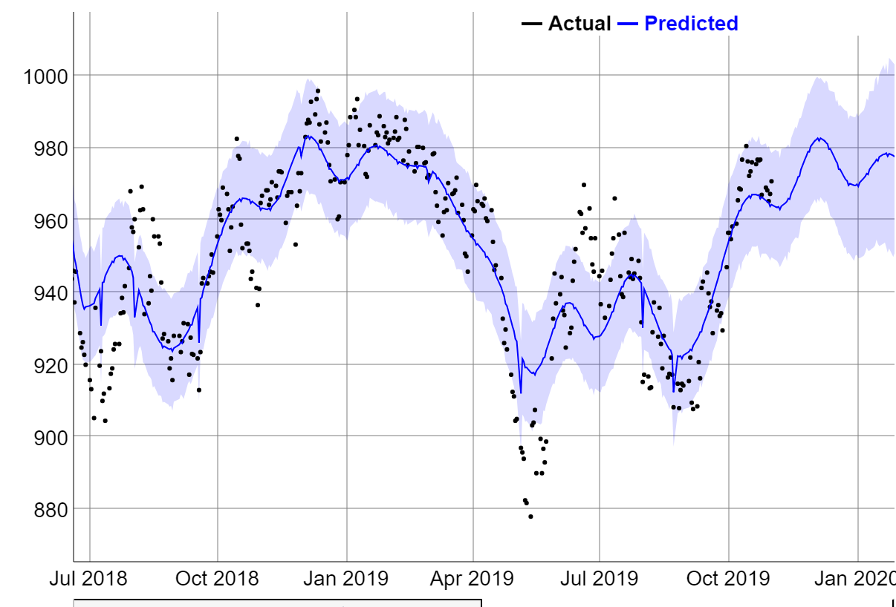
Trump’s Tweets Do Not Affect our Prediction
Only short term effects and not change trends of price

Slide 18
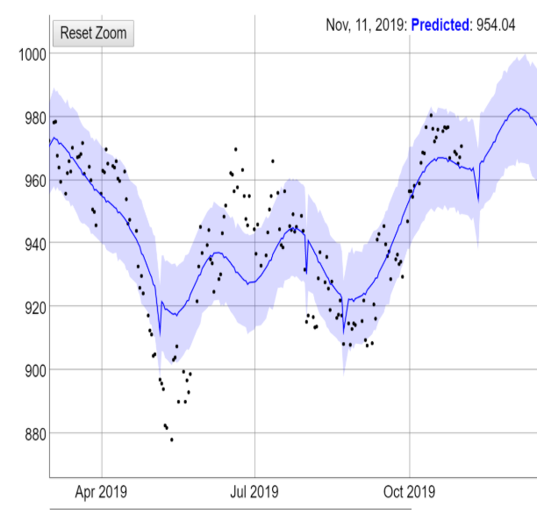
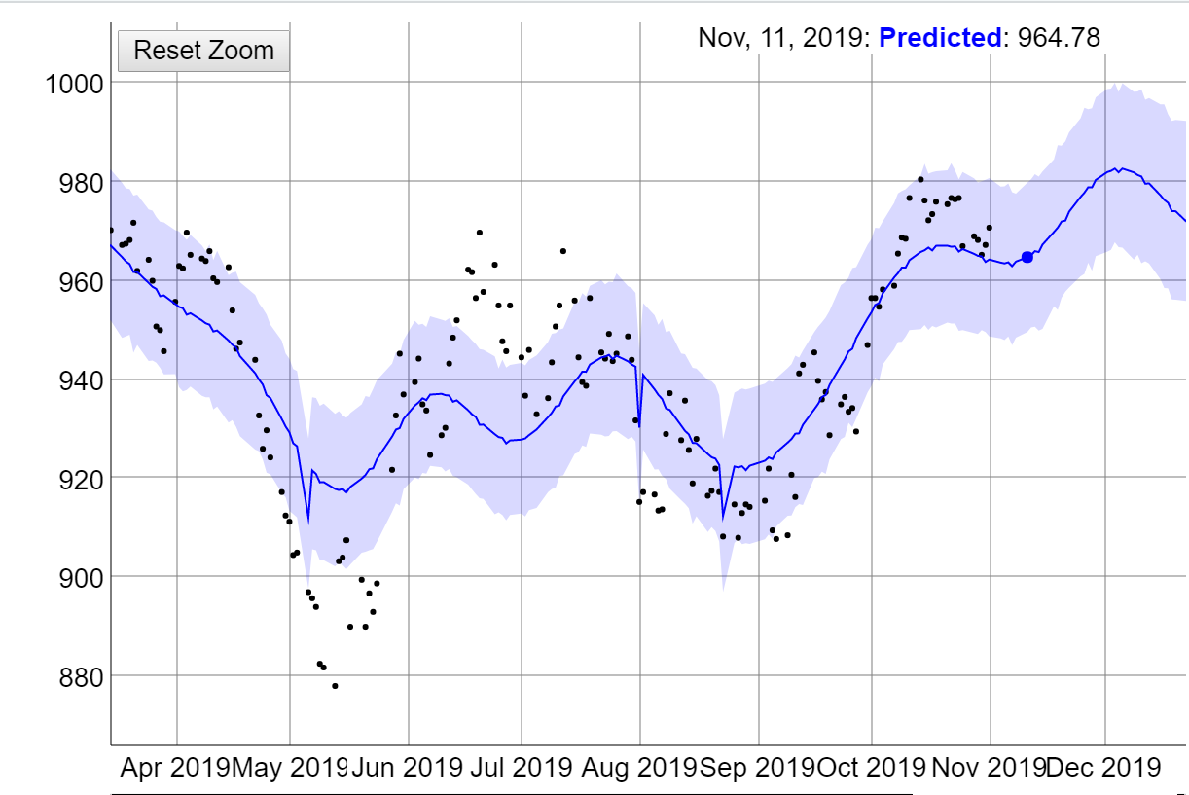
Sensitive Analysis on Trump’s Tweets
10 cents price decrease if Trump say US will continue add tariff in Nov 11

Slide 19
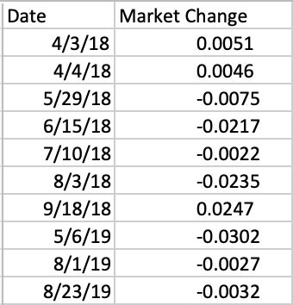
Tariff Tweets Have Minimal Effect on Market Price
There is no significant correlation between Tweets and soybean prices.
The tweets that mentioned tariff only have small effects on soybean prices.

Slide 20

Thank you!

Slide 21
Bibliography
https://www.reuters.com/article/us-usa-trade-china-soybeans-factbox/factbox-chinas-low-soy-pig-diet-and-the-impact-on-soybean-use-idUSKCN1LZ0KN
https://www.ers.usda.gov/webdocs/publications/93390/ocs-19f-01.pdf?v=3881
http://www.1nongjing.com/201708/197790.html
https://www.reuters.com/article/us-usa-trade-china-soybeans-factbox/factbox-chinas-low-soy-pig-diet-and-the-impact-on-soybean-use-idUSKCN1LZ0KN
https://www.zhifure.com/snzfj/66051.html
https://www.forbes.com/sites/kenroberts/2019/10/11/chinese-purchase-of-us-soybeans-have-ticked-up-but-true-test-is-the-next-45-days/#38d549bc4cad
http://www.farmers-exchange.net/detailPage.aspx?articleID=19246
https://www.reuters.com/article/us-china-economy-trade-soybeans/chinas-august-soy-imports-from-u-s-surge-as-cargoes-clear-customs-idUSKBN1WA0OX
https://www.wsj.com/articles/u-s-china-to-remove-tariffs-bit-by-bit-if-partial-deal-clinched-says-beijing-11573129323
https://www.nationalgeographic.com/magazine/2018/02/feeding-china-growing-appetite-food-industry-agriculture/

Slide 22
Articles
“Factbox: China's low-soy pig diet and the impact on soybean use”, Josephine Mason, Hallie Gu.
“Interdependence of China, United States, and Brazil in Soybean Trade”, Fred Gale, Constanza Valdes, and Mark Ash
“Pig Fodder Ingredient in China” , Yi Xie.
“How to make a good pig fodder, what is the good recipe”, Lu Xiaojiao.
“Don't Expect a Huge Bounce from the Signing of Phase 1 Trade Deal”, The Farmer’s Exchange
“How China Plans to Feed 1.4 Billion Growing Appetites” , TRACIE MCMILLAN
“China Says Tariffs Will Go, But U.S. Doubts Remain”, WSJ
“Chinese Purchases Of U.S. Soybeans Have Ticked Up, But True Test Is The Next 45 Days”, Ken Roberts
“China's August soy imports from U.S. surge as cargoes clear customs”, REUTERS
Notes:
Articles
Titles with dates and

Slide 23
Executives and Experts
Marta Ryvak - Senior Trader at Gresham Investment Management
Jeffrey Cutter - Managing Member at Bridgewater Homes LLC
Huatian He - Farm Manager and Veterinarian at Wens Corp.
Yvonne Galusha - Lecturer, Tippie College of Business, University of Iowa
Gregory Stoller - Senior Lecturer at Boston University Questrom School of Business
Brock Tibert - Lecturer (Information Systems), Analytics and Product Consultant.
Notes:
Names and position titles

